Slide 1

Are human activities influencing climate change
Notes:
Following on from the previous lesson assess previous learning. What is climate change, what is climate, what is the greenhouse effect? What are the greenhouse gasses?

Slide 2
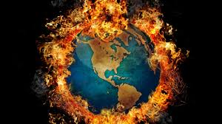
Are humans heating up the planet?
In some ways climate change is nothing new as the atmosphere changes all the time.
The Earth’s atmosphere has evolved over millions of years.
So critics deny the enhanced greenhouse effect as being human induced.

Slide 3
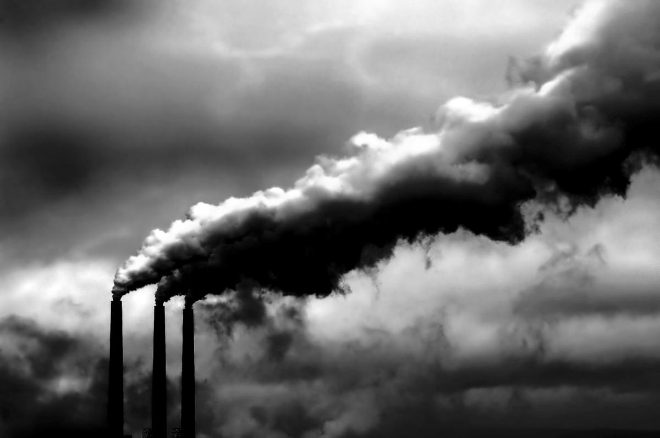
For the first two billion years of the Earth’s life the atmosphere was mostly Carbon dioxide.

Slide 4
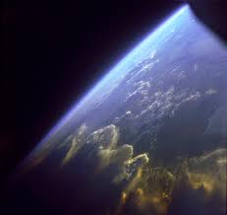
Over the next two billion years green plants evolved removing the carbon and producing oxygen.
As the plants died, the carbon that was locked within them was buried under ground – creating our fossil fuels.
In the last billion years the build-up of oxygen created the ozone layer that blocked the harmful rays from the sun and allowed complex organisms like us to develop.

Slide 5
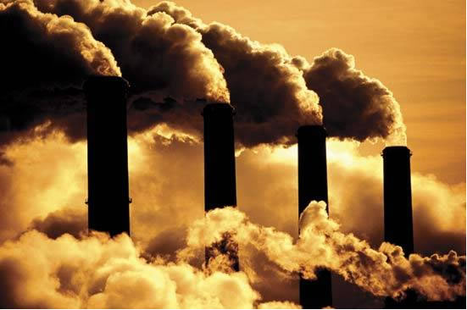
Today there should be virtually no carbon dioxide in our atmosphere, however, with deforestation and the burning of fossil fuels the locked-up carbon is released and the levels of it in our atmosphere are rising.
Watch the first part of hot planet on you tube which proves climate change happening faster since the industrial revolution.

Slide 6
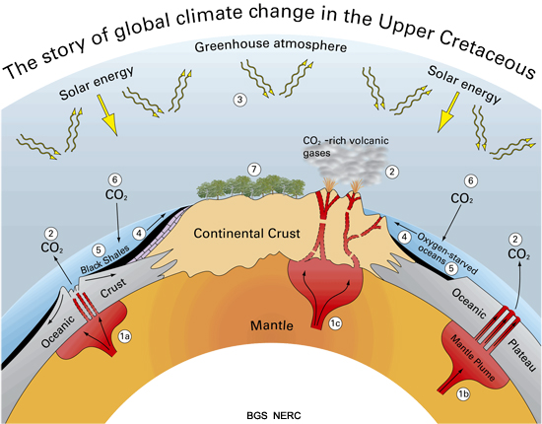

Slide 7
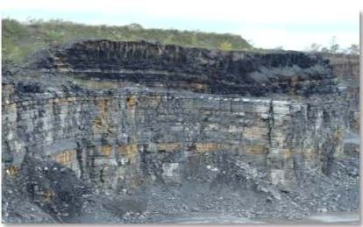
Black Shale Resource

Slide 8


Slide 9

What other human activities do you think could relate to climate change?
Driving a car
Flying by plane
Travelling by bus or train
Electric lights
Watching TV
Using the computer
Washing and drying clothes
Cooking a meal
Heating your home
Notes:
Give your learners time to write a list, or pick learners out and ask them what they think? There are obviously more than this however these are just a few examples of everyday activities. Ask them to order their list in terms of what they think could create the most greenhouse gas and why? This could then link on to thinking about how greenhouse gasses could be reduced. Eg. Car sharing etc.

Slide 10
Key human activities relating to Climate Change
Burning of fossil (mineral) fuels
Poor use of land
Waste disposal
Cooling units
Notes:
Ask learners what they think the main human activities are that relate to climate change.

Slide 11
Burning fossil fuels
Burning fossil fuels is the biggest contributor to increased levels of greenhouse gases in the atmosphere
Mineral fuels constitute major energy sources for industries such as transport and heating our homes. Minerals used are:
Petroleum
Natural gas
Coal
It is estimated that burning of fuels (world wide) produces
around 21.3 billion tons (21.3 gigatons) of carbon dioxide
every year.
Notes:
Ask the learners what they think the minerals are, then which mineral they think contributes the most towards gasses released. Might also be worth elaborating on the actual impact of 21.3billion tonnes (a gigaton is 1billion tons). What weighs that much? An example could be, The World trade centre was around 500,000 tons, so x2 was 1billion tons, meaning 42 world trade centres =‘s 21billion tons.

Slide 12
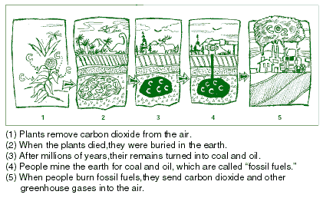
Fossil Fuels explained
Plants remove carbon dioxide from the air
When the plants die, they are buried within the earth
After millions of years, their remains are turned in to coal and oil
People mine the earth for coal and oil – these are called ‘fossil fuels’
When fossil fuels are burned, they send carbon dioxide and other greenhouse gases in to the air
Notes:
Test learners here, ask them how they think fossil fuels are created, then test on the carbon cycle.

Slide 13
Human activities are resulting in an increase in greenhouse gases
Major Findings about Greenhouse Gases
Since 1750, the concentration of CO₂ in the atmosphere has increased by 31%
Current CO₂ concentration and methane concentrations (CH₄) are at their highest level in the last 420,000 years.
CO₂ is increasing at a faster rate today than at any time over the past 20,000 years.
Notes:
Could recap here on previous lesson do learners understand remember the different greenhouse gases.

Slide 14
Poor use of land
When soil and vegetation is lost, more carbon dioxide is released in to the atmosphere, resulting in further global warming. Due to this, poor use of land is directly linked to climate change.
  Examples of poor use of land include:
  Uncontrolled urban development
  Destruction of forests
  Excessive farming
Notes:
Ask learners what they think ‘Poor use of land’ is. Ask for examples.

Slide 15
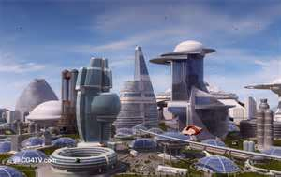
What do you think uncontrolled urban development is?
Uncontrolled urban development is the rapid growth of cities in developing countries, often resulting in turning agricultural land into urban settlements.
As a result, there is a lack of infrastructure to support this growth, which creates unsustainable consumption of land, water and other natural resources, which in turn, accelerates environmental degradation and the negative impacts of climate change.
Notes:
The ask learners the question and answers can be discussed before revealing the summary below.

Slide 16
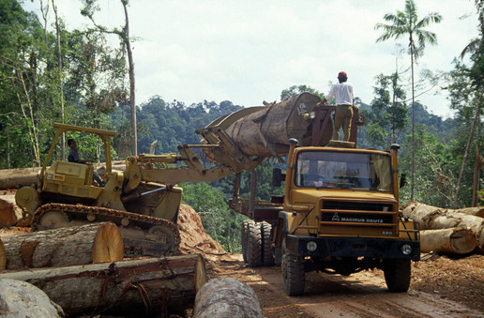
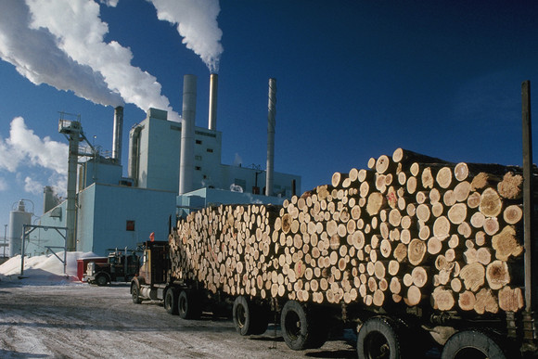
Deforestation
Mature forests store enormous quantities of carbon, which is released into the atmosphere when they are cut down.
both in the trees and vegetation itself and within the
soil in the form of decaying plant matter.

Slide 17
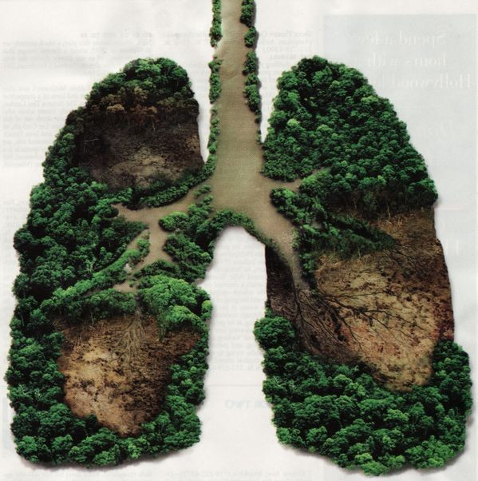
Deforestation
As our understanding of the role forests play in stabilising global climate increases, it is becoming clear that their destruction is only increasing the acceleration of climate change.
Forest covers 30% of the world’s land area.
We are destroying 28,000 square miles a year.
Notes:
Make sure learners understand that cutting trees down is releasing carbon into the atmosphere. Relate this to how much is being destroyed, thats a lot of greenhouse gasses.

Slide 18

Reforestation, conservation & climate change prevention
By protecting the rainforests, we are aiding the of climate change as well as ensuring the survival of many species of animals, plants and trees.
prevention
is one of the main causes of habitat loss and extinction of many animals on the planet. By cutting down trees, we are not only contributing to a rapid increase in but we are ruining the survival chance for species all over the world
The AWF helps schools and businesses to become by supporting fundraising activities to purchase land. This will provide jobs for local , provide valuable education and most of all, land, in turn preventing
Deforestation
greenhouse gases
carbon neutral
communities
conserve
climate change
Notes:
Use the slide to give an overview of deforestation and greenhouse gases. Teachers can use the gaps between text, to test learners on their knowledge.

Slide 19
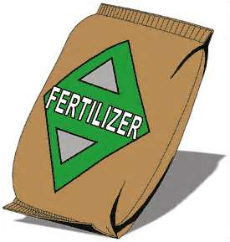
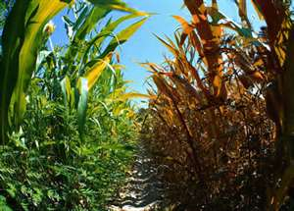
How does agriculture contribute to climate change?
The use of synthetic fertilisers and pesticides are the biggest
contributor to climate change in agriculture.
This is because they are manufactured using oil and natural
Gas. Nitrogen fertiliser also gives off nitrous oxide,
a greenhouse gas.
As well as this, cow and sheep digestive tracts also produce
CH4 (Methane).
Land conversion is another significant
contributor. For the most part,
extensive grasslands
(6m hectares a year) and forests (7m hectares)
are converted to crop land.
The loss of CO2 into the atmosphere above ground
(trees and plants) and underground, as a result, (soil organic matter) is enormous
Notes:
Discuss the bullet points in more detail, placing emphasis on the gases involved with agriculture.

Slide 20
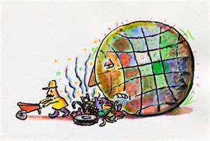
Waste Disposal
Greenhouse gas emissions such as methane and carbon dioxide are produced as a result of waste not being properly
treated or disposed of.
These gases contribute to global warming

Slide 21
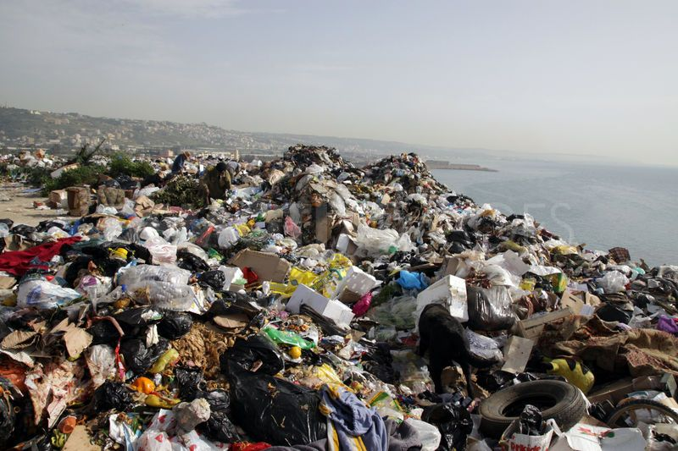

Waste Disposal
Landfill disposal of waste is a key
source of man-made methane
emissions in the atmosphere. This is because when waste is compacted in landfill, there is no oxygen and it is not able to decompose properly, producing greenhouse gases
This is why it is so important to
reduce waste or recycle it.

Slide 22
What is composting?
Composting your household food waste is a way of disposing of your food without it producing greenhouse gases.
This is because composting allows the waste to be aerated, allowing it to decompose fully.
Once it is decomposed, you can put it on your garden
as an alternative to synthetic fertilizers.
Notes:
use the title to establish how much learners know about composting. The difference between composting and landfill.

Slide 23
Cooling Units
Can you give an example of a ‘cooling unit?’
Chlorofluorocarbons (CFCs) and hydrochlorofluorocarbons (HCFCs) used as coolants in fridges, freezers and air conditioners are a major source of ozone layer depletion.
These coolants have now been replaced with substitutes
such as hydroflurocarbons (HFCs).
Notes:
Get learners to give you as many examples of cooling units as possible.

Slide 24
Within the UK, regulatory measures have been taken to phase out the use of such coolants in cooling appliances and aerosol sprays.
The use of HFCs is restricted within the UK as they also
contribute to the green house gas effect.
Notes:
Continued from previous slide. The focus of this slide can be more about the improvements already put in place.

Slide 25
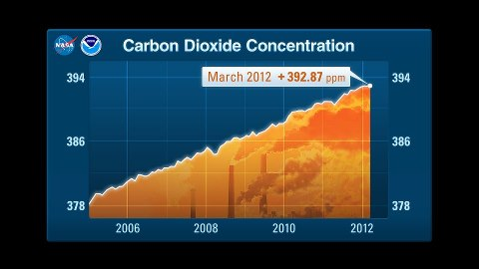
Carbon dioxide concentrations are dangerously on the rise
Notes:
Use the diagram to show learners the rise in CO2 concentrations and the implications of this rise.

Slide 26

Simple steps to help prevent Climate Change?
Ride a bike or walk instead of going by car.
Turn the lights off when you leave the room.
Don’t leave the TV on standby – turn it off at the wall.
Recycle and compost as much as possible
Eat less meat and dairy products. Animals produce methane which is one of the most damaging greenhouse gases.
Plant trees - Planting trees is fun and a great way to reduce greenhouse gases. Trees absorb carbon dioxide from the air.
Buy recycled products which don’t use ‘new’ resources and don’t require so much energy to make. Buy energy efficient electrical goods.
Buy local produce and products
Notes:
Ask your learners to elaborate on the answers to this question.. E.g. If the answer, plant a tree is given, ask why, provoke deeper thought. Why would you plant a tree? Ask this question across the class if the learner cannot answer the question. It’s important for the learners to understand why you would plant a tree, what do this, etc. This applies to all answers. Understanding why, is important.

Slide 27


How your school can help prevent Climate Change
Calculate your footprint
AWF can help your school calculate it’s carbon footprint – follow the link below for more details
Fundraise
Download a free fundraising pack from AWF by following the link below
Go carbon neutral
Go carbon neutral by protecting forests globally – follow the link for more details
http://www.awf-genesisproject.org/
Notes:
By using the images provided, see if learners can guess what ways your school can help prevent climate change. Test their knowledge on how each bullet point can be established. Teachers could get learners to come up with fundraising ideas.

Slide 28

Climate Change and the AWF
The aim of AWF project is to plant trees through forestry projects around the world that work alongside local communities to provide social, ecological and conservational benefits.
http://missiongalacticfreedom.wordpress.com
Notes:
Can elaborate on what we are doing to help if possible. It is important for the role we play to be put across in a positive way through our PowerPoint's.

Slide 29
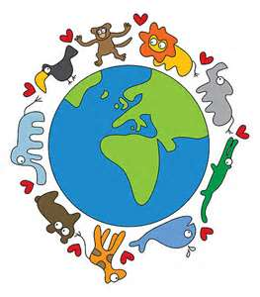
REDUCE
REUSE
RECYCLE
http://www.awf-genesisproject.org/
Notes:
Reduce, Reuse and Recycle – This slide can be used to summarise the lesson.

